Slide 1
Hypergeometric Distribution
Prepared by
Sajana Shakya

Slide 2
Suppose a population consists of N items, K of which are classified as successes and N-K are classified as failures. Let sample of size n is taken randomly without replacement from population and x be the number of successes resulted from experiment. Then this is called hypergeometric experiment.

Slide 3
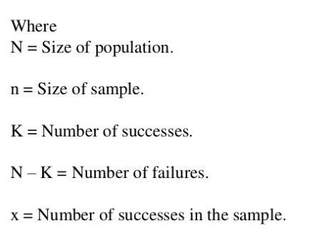

Slide 4
Conditions for Hypergeometric distribution:
Whole population is classified into two groups. Success/Failure
Every selection if done without replacement
The probability of success is not constant on every trial.
The trials are dependent

Slide 5
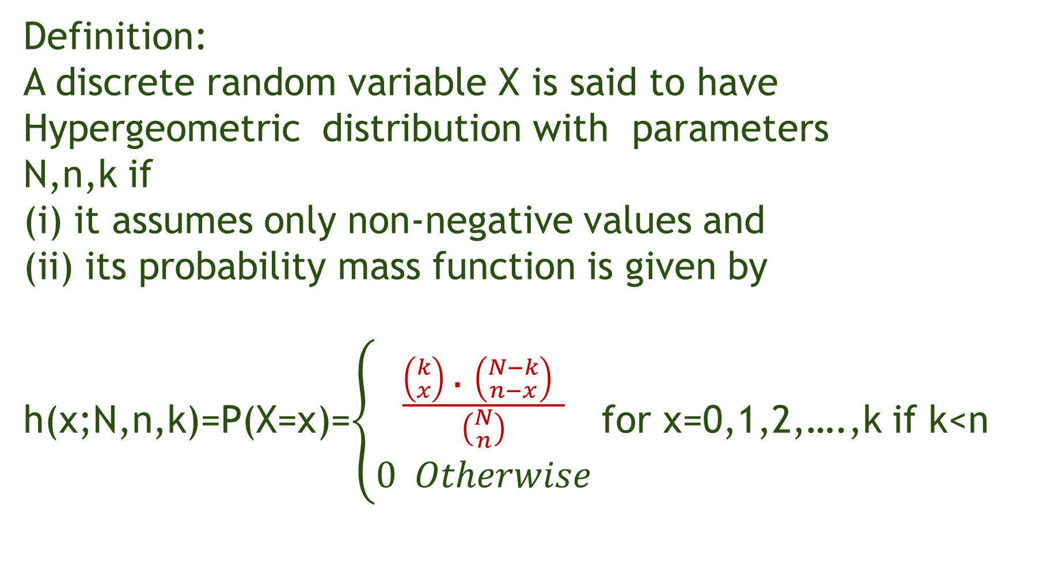
Definition:
A discrete random variable X is said to have Hypergeometric distribution with parameters
N,n,k if
(i) it assumes only non-negative values and
(ii) its probability mass function is given by h(x;N,n,k)=P(X=x)=$\left\{\begin{aligned}\frac{\left({k \atop x}\right)\text{ .} \left({N−k \atop n−x}\right) }{\left({N \atop n}\right)} \\ 0 Otherwise\end{aligned}\right.$ for x=0,1,2,….,k if k<n

Slide 6
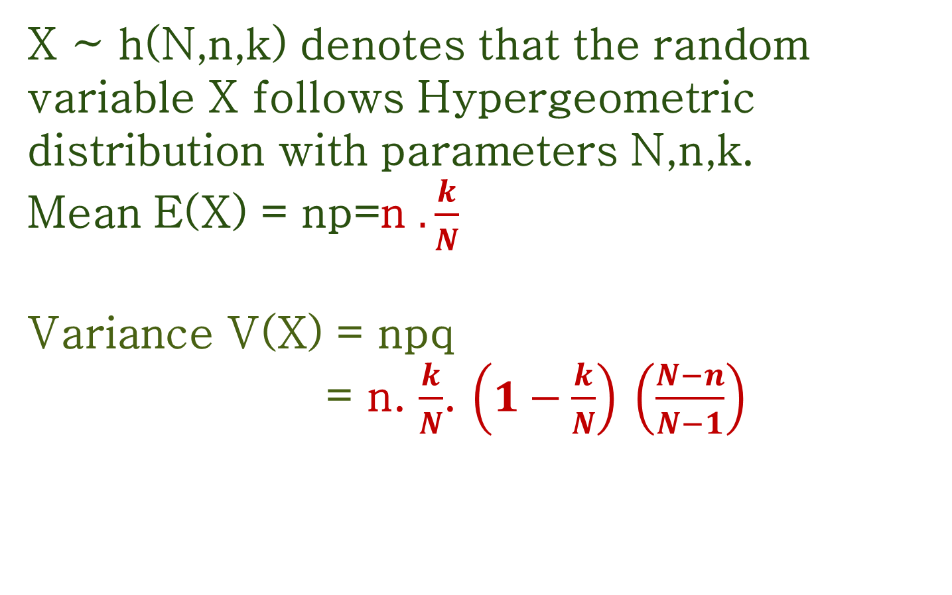
X ~ h(N,n,k) denotes that the random variable X follows Hypergeometric distribution with parameters N,n,k.
Mean E(X) = np=n $. \frac{k}{N}$
Variance V(X) = npq
= n. $\frac{k}{N}$. $\left(1−\frac{k}{N}\right)$ $\left(\frac{N−n}{N−1}\right)$

Slide 7
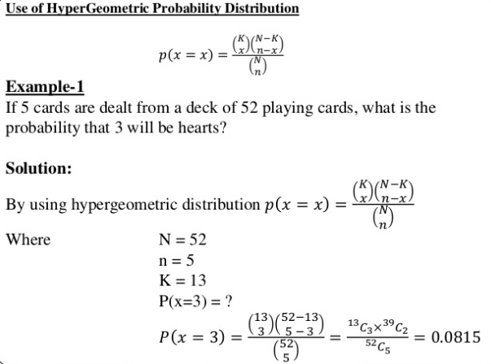

Slide 8
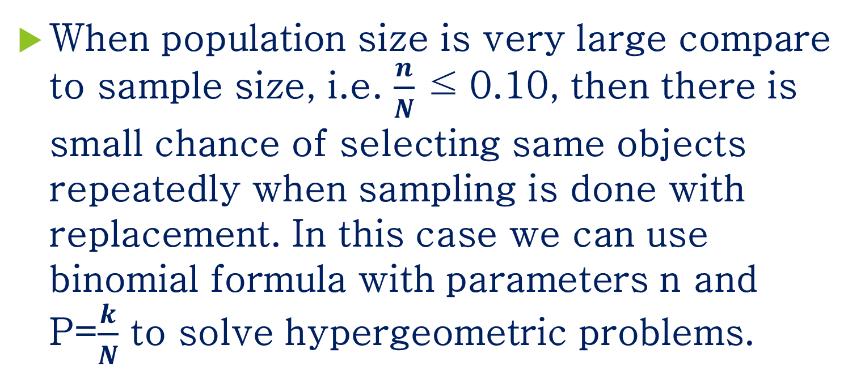
Binomial distribution as an approximation to Hypergeometric distribution:
When population size is very large compare to sample size, i.e. $\frac{n}{N}$ ≤ 0.10, then there is small chance of selecting same objects repeatedly when sampling is done with replacement. In this case we can use binomial formula with parameters n and P=$\frac{k}{N}$ to solve hypergeometric problems.

Slide 9
Problem 1:
From a lot containing 17 items, 7 of which are defective, 6 are chosen at random. Find the probability of
(i) 4 or 5 defective
(ii) at least 4 defective
(iii) at most 2 defective
(iv) 4 defective and 2 non defective items.

Slide 10
Problem 2:
From In a ward, there are 121 houses in which 65 of them are new. Find the probability that 7 houses are old out of 25 houses selected randomly.

Slide 11
Problem 3:
Among the 300 employees of a company, 240 are union members, while the other are not. If 8 of the employees are chosen by lot to serve on the committee, which administers the pension fund, find the probability that five of them will be union members while the others are not, by using
(a) the formula for the hypergeometric distribution
(b) the formula for the binomial distribution as an approximation.

